Slide 1
Jan2018 HL7 Work Group Meeting Trip Report Steve Hufnagel PhD, HL7 facilitator and HL7 co-chair
HL7 is in a state of rapid transition, since the ‘2010 introduction of Fast Healthcare Resources (FHIR) and the ‘2016 arrival of the Clinical Information Model Initiative (CIMI); where,
FHIR makes interface implementations faster and cheaper; where, CIMI’s Healthcare common logical information model CLIM (SOLOR, FHIM, CIMI, CQF) makes FHIR better.
HL7 is moving to four “interoperable” product lines. The V2, V3, CDA, FHIR and CIMI product lines, management groups and respective families. Their collective goal is clear, complete, concise, correct, consistent and traceable computable interoperability-specifications and implementation guides, which are efficient and effective to implementers, thereby, contributing to patient value (safety, quality, cost).

Slide 2


CIMI makes FHIR better, with FHIM & SOLOR pre-requisites Integrated Model Stack - Each Plays a Role
KNART-FHIR
KNART-FHIR
eCQM-FHIR
eCQM-FHIR
DCM-FHIR
DCM-FHIR
eCQM-FHIR
DCM-FHIR
CQI
CQF
CDS
DCM-FHIR`
DCM-FHIR
DCM-FHIR
Other
Initiatives
CIMI
FHIM
DCM-FHIR
DCM-FHIR
SOLOR
See
Notes
Page
DCM - Detailed Clinical Models KNART– Knowledge Artifact
FHIM – Federal Health Information Model SOLOR – SNOMED, LOINC, RxNorm
Notes:
As shown in this slide, each model contributes to an Integrated Model Stack, the proposed operational architecture involves the definition of clinical knowledge in the form of formally modeled information artifacts that could be used in compose-able health records, care plans and other shared clinical data. As represented in this slide, the combination of SOLOR, FHIM, CIMI DCMs and CQF KNARTs while complementary fulfill a different information modeling contribution.
SOLOR is SNOMED with extensions for LOINC and RXNorm.
FHIM is Federal Health Information Model
CIMI DCMs is Clinical Information Model Initiative Detailed Clinical Model
CQF KNARTs is Clinical Quality Framework Knowledge Artefacts

Slide 3
CIMI makes FHIR better, with FHIM & SOLOR pre-requisites Talking Points: Integrated Model Stack - Each Plays a Role
`
Interoperability requires a common understanding of the data. The FHIM provides that. It can be used to generate FHIR profiles that reflect realm-specific requirements (e.g., ONC, CMS regs & directives). It can do that whether it's married to CIMI or not, but we hope to leverage the clinical specificity of CIMI as well. FHIM should be the US Realm information model for the FHA.
As shown in this slide, each model contributes to an Integrated Model Stack, the proposed operational architecture involves the definition of clinical knowledge in the form of formally modeled information artifacts that could be used in compose-able health records, care plans and other shared clinical data. As represented in this slide, the combination of SOLOR, FHIM, CIMI DCMs and CQF KNARTs while complementary fulfill a different information modeling contribution.
SOLOR is SNOMED with extensions for LOINC and RXNorm.
FHIM is Federal Health Information Model
CIMI DCMs is Clinical Information Model Initiative Detailed Clinical Model
CQF KNARTs is Clinical Quality Framework Knowledge Artefacts
Model Driven Development tools can autogenerate clear complete, concise, correct and consistent FHIR/CDA/NIEM implementation guides and artefacts.
Notes:
As shown in this slide, each model contributes to an Integrated Model Stack, the proposed operational architecture involves the definition of clinical knowledge in the form of formally modeled information artifacts that could be used in compose-able health records, care plans and other shared clinical data. As represented in this slide, the combination of SOLOR, FHIM, CIMI DCMs and CQF KNARTs while complementary fulfill a different information modeling contribution.
SOLOR is SNOMED with extensions for LOINC and RXNorm.
FHIM is Federal Health Information Model
CIMI DCMs is Clinical Information Model Initiative Detailed Clinical Model
CQF KNARTs is Clinical Quality Framework Knowledge Artefacts

Slide 4
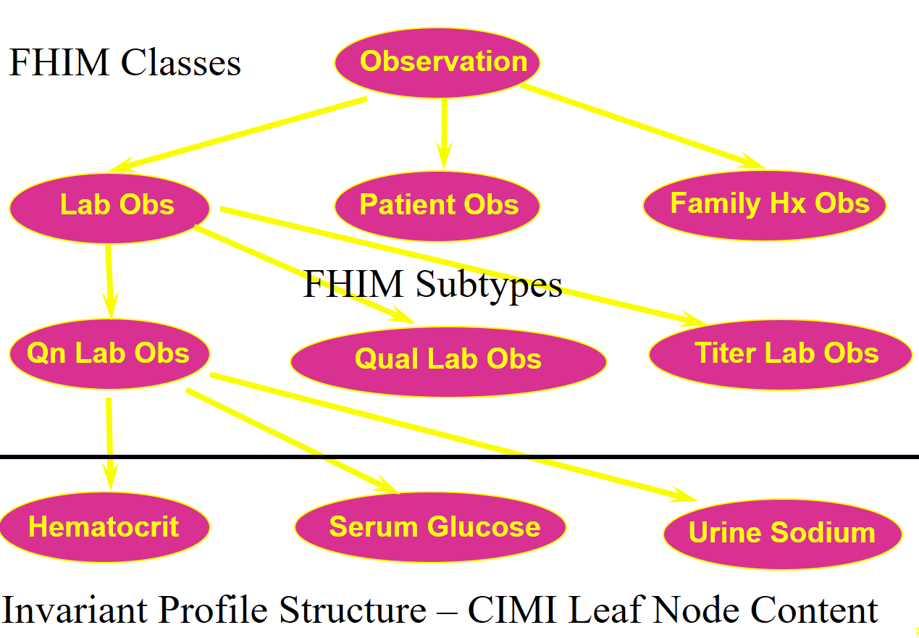
Clinical Example CIMI-FHIM Integration
CQF Knowledge Artifacts
SOLOR Terminology
FHIM Classes
CIMI DCMS
Notes:
“CIMI makes FHIR better” with FHIM and SOLOR pre-requisites.
Is FHIM still needed? YES, where, FHIM is being assimilated into HL7
CIMI relies on FHIM as do CIC and EHR WGs
CIMI wants to ballot FHIM as its healthcare Reference Domain Information Model (RDIM)
EHR WG and CIC want to ballot FHIM within their Reference Domain Analysis Model (RDAM)
FHIM value to the agencies, vendors, or healthcare systems?
FHIM is a priceless SME requirements repository, containing over 10 years of clinical knowledge.
FHIM is essential to Model Driven Development (MDD) traceability and consistency
CDA templates and FHIR structure definitions
How does FHIM make FHIR better?
FHIM is the uber model, constrained into consistent CIMI DCMs, FHIR Structure Definitions, CDA/NIEM templates
FHIM is where clinicians and implementers can seamlessly share knowledge
Why sustain FHIM?
Efficient and effective Model driven development relies on a trusted and consistent reference model, e.g., FHIM
Elevator speech: Collectively, FHIM-CIMI-SOLOR-FHIR are a big 21st Century Cures Act Enabler
FHIM Domains are constrained into CIMI detailed clinical models (DCMs),
DCMs are bound with SOLOR terminology semantics
SOLOR-DCMs are transformed into consistent and traceable
FHIR Structure Definitions and CDA/NIEM templates, using MDD, e.g., SIGG (MDHT, MDMI).
21st Century Cures act requires efficient-and–effective data sharing templates requiring rapid MDD customizations.
DoD, VA and HIE information sharing requirements are constantly changing
Implementers want faster-cheaper tools to build interfaces and information exchange artefacts
FHIM-CIMI-SOLOR make FHIR faster-better-cheaper!

Slide 5
Talking Points: FHIM Value Proposition
“CIMI makes FHIR better” with FHIM and SOLOR pre-requisites.
Is FHIM still needed?
YES, where, FHIM is being assimilated into HL7
CIMI relies on FHIM as do CIC and EHR WGs
CIMI wants to ballot FHIM as its healthcare Reference Domain Information Model (RDIM)
EHR WG and CIC want to ballot FHIM within their Reference Domain Analysis Model (RDAM)
FHIM value to the agencies, vendors, or healthcare systems?
FHIM is a priceless SME requirements repository, containing over 10 years of clinical knowledge.
FHIM is essential to Model Driven Development (MDD) traceability and consistency
CDA templates and FHIR structure definitions
How does FHIM make FHIR better?
FHIM is the uber model, constrained into consistent CIMI DCMs, FHIR Structure Definitions, CDA/NIEM templates
FHIM is where clinicians and implementers can seamlessly share knowledge
Why sustain FHIM?
Efficient and effective Model driven development relies on a trusted and consistent reference model, e.g., FHIM

Slide 6
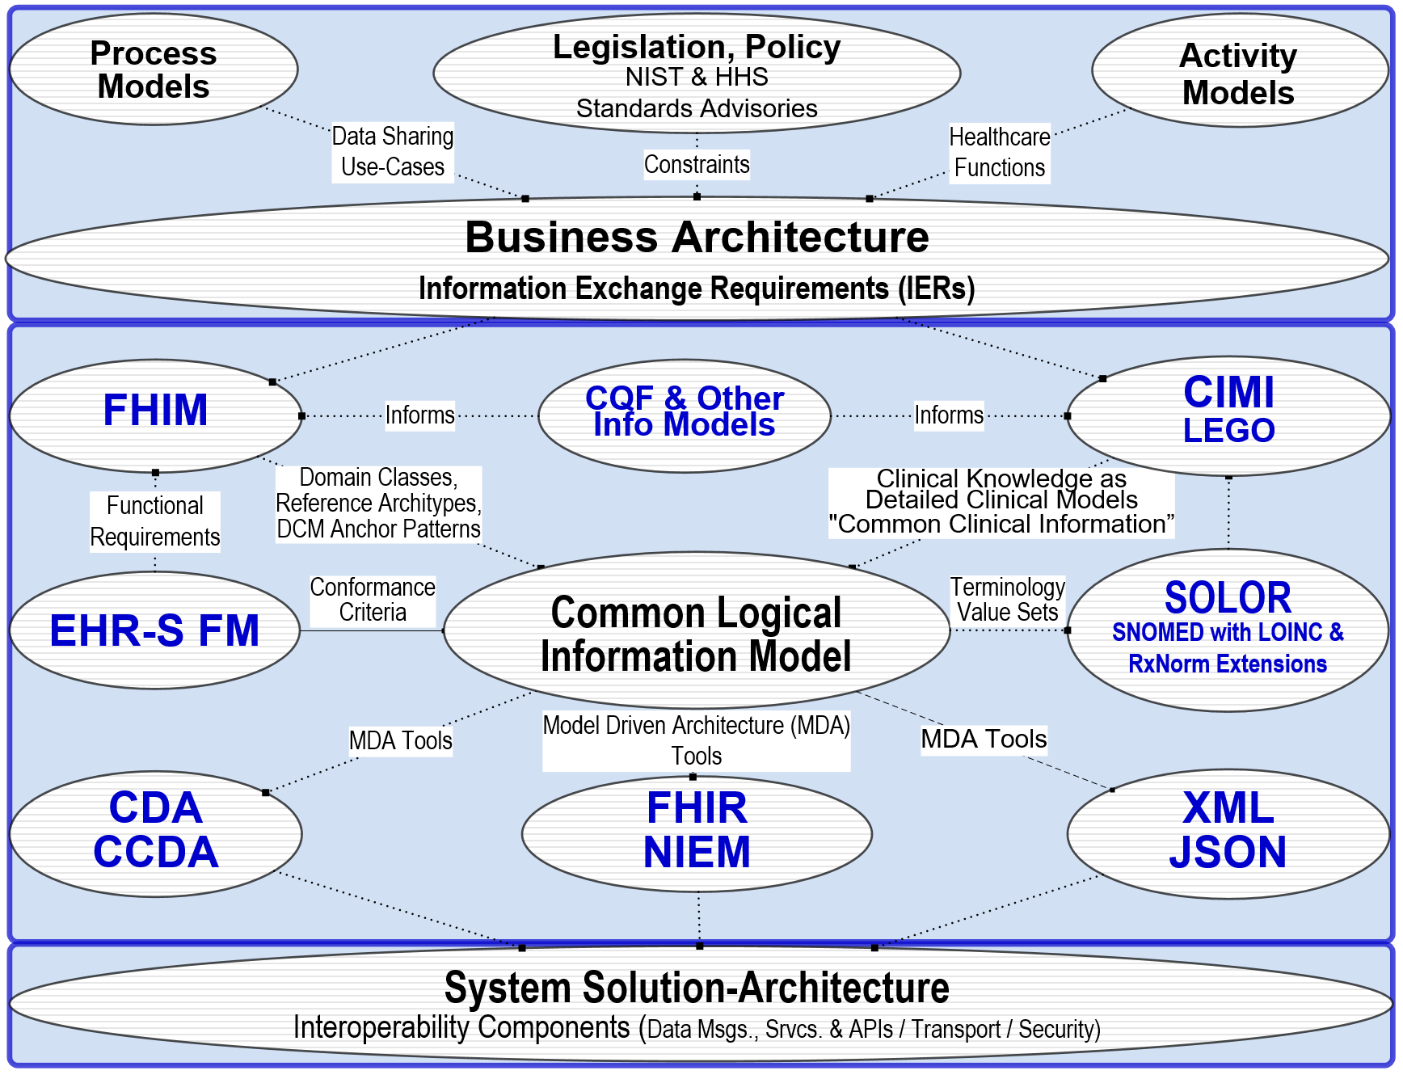
High Level Architectural View
The emerging solution involves the definition of clinical knowledge in the form of formally modeled information artifacts that could be used in compose-able health records, care plans and other shared clinical data. Each information artefact will be defined with an unambiguous and computable meaning, employ a specific, shared vocabulary, and have a specific information structure.
See Notes Page
Notes:
The High-Level Architectural-View slide shows how CIMI-FHIM-SOLOR-CQF Integration enables Consistent “Foundational Health Information” and “Common Clinical Information” to support Computable Semantic-Interoperability in “Continuum of Care” Implementations and aggregated, portable and computable patient-records, care plans, clinical knowledge and other shared healthcare information.
The top Business Architecture typically includes:
Legal, ethical requirements, policies and rules
Societal/organizational (e.g., cities, states and countries) requirements
EHR-system requirements
Vocabulary (Shared: Syntax, words, phrases)
Ways to present and enter data via screens, forms, etc.
Notions about archiving/documentation/information security
Care quality measurement and improvement through clinical knowledge
The center Information architecture, includs:
FHIM, EHRS-FM and CQF, which consolidate Health domain requirements
CIMI and LEGO; where, LEGO is the Q&A subset of CIMI, using the CIMI Observation Model and Description Logic.
Other Info Models, e.g., CQF, SDC, DAF, V2, CCD, etc. –
SOLOR Terminology and Value Sets based on SNOMED-CT expressions.
The bottom Solution Architecture includes:
EHR-systems with CCDA, FHIR, NIEM, JSON API, RDF, HL7 V2 & V3 interfaces among EHR-system Services.
Supporting services (Terminologies, Terminology servers (e.g., SOLOR), Value set servers, Protocol servers, Clinical guideline servers, clinical decisions support servers, Presentation/data input services, Exchange services)
Technical Infrastructural services: networks, internet, information security,
Hardware and Software
with a clear separation of semantics.

Slide 7
Talking Points: Proposed Solution High Level Architectural View
The High-Level Architectural-View slide shows how CIMI-FHIM-SOLOR-CQF Integration enables Consistent “Foundational Health Information” and “Common Clinical Information” to support Computable Semantic-Interoperability in “Continuum of Care” Implementations and aggregated, portable and computable patient-records, care plans, clinical knowledge and other shared healthcare information.
The top Business Architecture typically includes:
Legal, ethical requirements, policies and rules
Societal/organizational (e.g., cities, states and countries) requirements
EHR-system requirements
Vocabulary (Shared: Syntax, words, phrases)
Ways to present and enter data via screens, forms, etc.
Notions about archiving/documentation/information security
Care quality measurement and improvement through clinical knowledge
The center Information architecture, includs:
FHIM, EHRS-FM and CQF, which consolidate Health domain requirements
CIMI and LEGO; where, LEGO is the Q&A subset of CIMI, using the CIMI Observation Model and Description Logic.
Other Info Models, e.g., CQF, SDC, DAF, V2, CCD, etc. –
SOLOR Terminology and Value Sets based on SNOMED-CT expressions.
The bottom Solution Architecture includes:
EHR-systems with CCDA, FHIR, NIEM, JSON API, RDF, HL7 V2 & V3 interfaces among EHR-system Services.
Supporting services (Terminologies, Terminology servers (e.g., SOLOR), Value set servers, Protocol servers, Clinical guideline servers, clinical decisions support servers, Presentation/data input services, Exchange services)
Technical Infrastructural services: networks, internet, information security,
Hardware and Software
with a clear separation of semantics.
Notes:
The High-Level Architectural-View slide shows how CIMI-FHIM-SOLOR-CQF Integration enables Consistent “Foundational Health Information” and “Common Clinical Information” to support Computable Semantic-Interoperability in “Continuum of Care” Implementations and aggregated, portable and computable patient-records, care plans, clinical knowledge and other shared healthcare information.
The top Business Architecture typically includes:
Legal, ethical requirements, policies and rules
Societal/organizational (e.g., cities, states and countries) requirements
EHR-system requirements
Vocabulary (Shared: Syntax, words, phrases)
Ways to present and enter data via screens, forms, etc.
Notions about archiving/documentation/information security
Care quality measurement and improvement through clinical knowledge
The center Information architecture, includs:
FHIM, EHRS-FM and CQF, which consolidate Health domain requirements
CIMI and LEGO; where, LEGO is the Q&A subset of CIMI, using the CIMI Observation Model and Description Logic.
Other Info Models, e.g., CQF, SDC, DAF, V2, CCD, etc. –
SOLOR Terminology and Value Sets based on SNOMED-CT expressions.
The bottom Solution Architecture includes:
EHR-systems with CCDA, FHIR, NIEM, JSON API, RDF, HL7 V2 & V3 interfaces among EHR-system Services.
Supporting services (Terminologies, Terminology servers (e.g., SOLOR), Value set servers, Protocol servers, Clinical guideline servers, clinical decisions support servers, Presentation/data input services, Exchange services)
Technical Infrastructural services: networks, internet, information security,
Hardware and Software
with a clear separation of semantics.

Slide 8
Analogy
Lets consider all standards including CDA, FHIR etc bundled together as New Car
And the FHIM represents the owners manual
and for the sake of this analogy there is no such thing as garages or mechanic available
An implementer jumps into the car with the objective to drive to California from New York
you can make some progress on your trip but you soon need gas - without the owners manual you might find how to put gas in the car but you might pry open the gas cover versus using the lever under the seat
FHIM is user’s manual for implementers to build faster-better-cheaper interfaces.
You can get there (interoperability) without FHIM but FHIM adds value

Slide 9
Elevator speech: FHIM-CIMI-SOLOR-FHIR are a big 21st Century Cures Act Enabler
FHIM Domains are constrained into CIMI detailed clinical models (DCMs),
DCMs are bound with SOLOR terminology semantics
SOLOR-DCMs are transformed into consistent and traceable implementation Artefacts
FHIR Structure Definitions and CDA/NIEM templates, using MDD
, e.g., SIGG (MDHT, MDMI).
21st Century Cures act requires efficient-and–effective data sharing templates
requiring rapid MDD customizations.
DoD, VA and HIE information sharing requirements are constantly changing
Implementers want faster-cheaper tools to build interfaces and information exchange artefacts
FHIM-CIMI-SOLOR make FHIR faster-better-cheaper!

